Slide 1


NATIONAL SECURITY: PATHWAY TO A TRILLION-DOLLAR ECONOMY
BY
GENERAL CHRISTOPHER GWABIN MUSA (RTD) OFR
HONOURABLE MINISTER OF DEFENCE
DELIVERED AT THE 56TH ANNUAL ACCOUNTANTS' CONFERENCE OF THE INSTITUTE OF CHARTERED ACCOUNTANTS OF NIGERIA (ICAN)
OCTOBER 2026

Slide 2
The lecture examines three key areas:
CONCEPTUALIZING NATIONAL SECURITY AS AN ECONOMIC IMPERATIVE
THE ROLE OF THE DEFENCE AND SECURITY SECTOR IN ECONOMIC TRANSFORMATION
NATIONAL SECURITY AND THE TRILLION-DOLLAR ECONOMY AMBITION
FOLLOWED BY PROPOSED STRATEGIC PATHWAYS FOR STRENGTHENING SECURITY IN SUPPORT OF ECONOMIC GROWTH

Slide 3
INTRODUCTION

Slide 4
CONCEPTUALIZING NATIONAL SECURITY AS AN ECONOMIC IMPERATIVE

Slide 5
CONCEPTUALIZING NATIONAL SECURITY AS AN ECONOMIC IMPERATIVE (CON’T)
This section examines:
The traditional vs. economic view of national security
Security as a foundation for economic growth
Scholarly perspectives on security and development
Nigeria's economic geography and security interdependence

Slide 6
CONCEPTUALIZING NATIONAL SECURITY AS AN ECONOMIC IMPERATIVE (CON’T)
From Operational Command to Defence Policy.
The Speaker's Perspective: Insights from operational command, strategic military leadership, and defence policy administration.
A Fundamental Conviction: "Military campaigns and success are important, but sustainable national security requires effective governance, economic viability, and credible institutions.“
The Core Thesis: Security is not merely a cost but an essential foundation for economic productivity and national prosperity.

Slide 7
CONCEPTUALIZING NATIONAL SECURITY AS AN ECONOMIC IMPERATIVE (CON’T)
The Traditional vs. Economic View of National Security. Redefining the Concept
Traditional View: Protection of sovereignty, territorial integrity, citizens and national institutions from internal and external threats.
Economic View: Security is an essential function that:
  Protects human and physical capital.
  Reduces uncertainty and the cost of doing business.
  Strengthens investor confidence.
  Safeguards critical infrastructure, supply chains and strategic national assets.

Slide 8
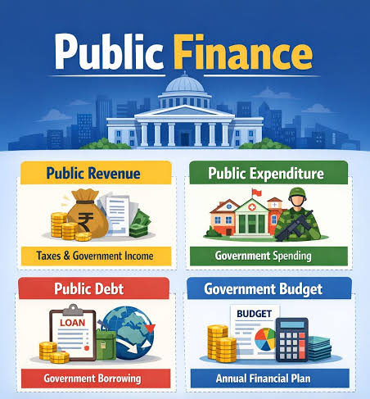
CONCEPTUALIZING NATIONAL SECURITY AS AN ECONOMIC IMPERATIVE (CON’T)
The Economic Imperative: Security as a Foundation for Growth. The Dual Impact of (In)Security on Public Finance
A Pressing Challenge: Insecurity places considerable pressure on public finance through increased expenditure on military operations and law enforcement.
The Fiscal Trade-off: While security expenditures are necessary, prolonged insecurity reduces the fiscal allocation available for education, healthcare, infrastructure, and other demands.
The Goal: To create a secure environment that enables prosperity and expands the national economic pie.
Source: MoD ALBUM, 2026

Slide 9
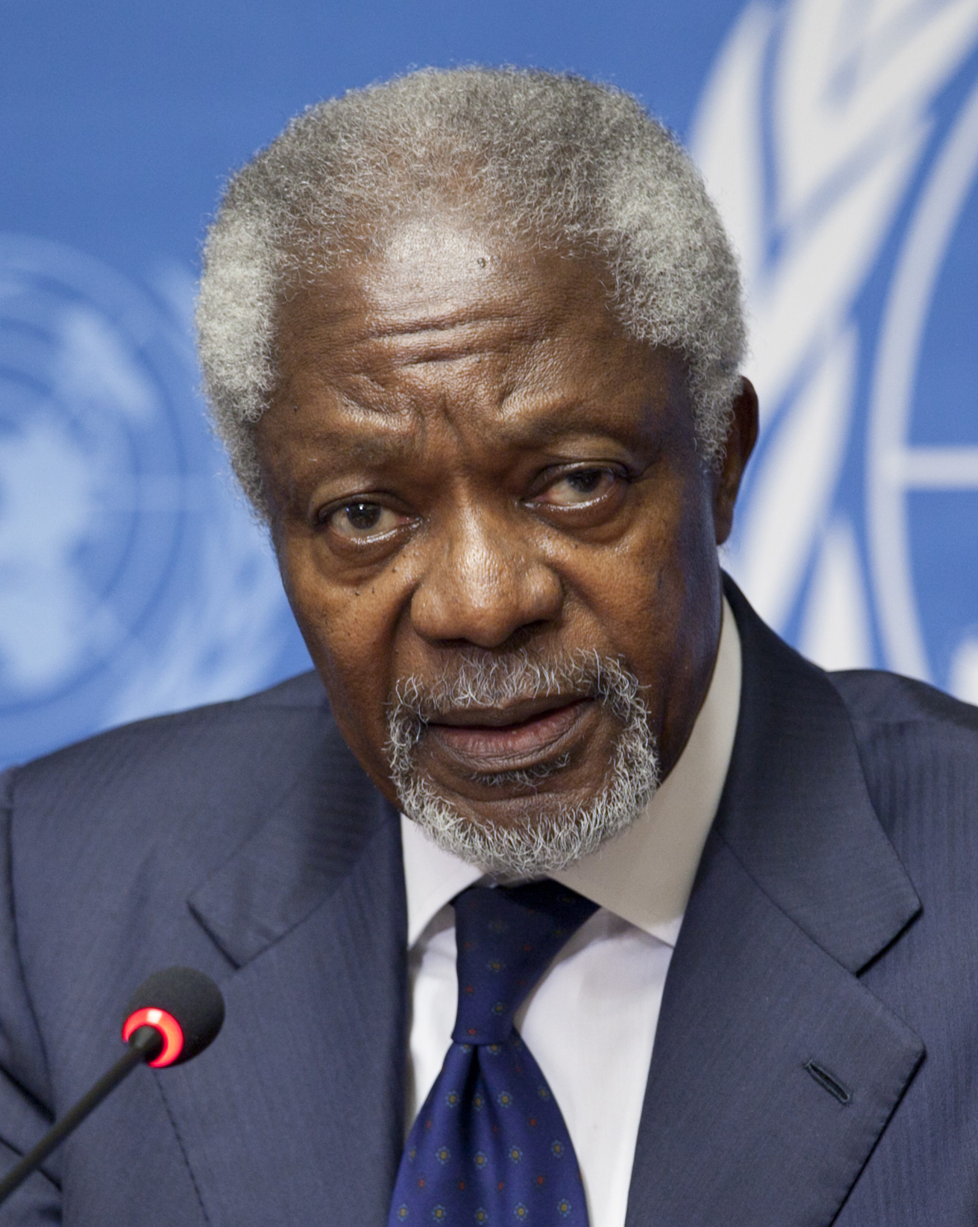
KEY PERSPECTIVES ON SECURITY AND DEVELOPMENT
Emphasises the importance of "there will be no development without security and there will be no security without security" in achieving meaningful development.
kofi Annan
Source: https://en.wikipedia.org/wiki/Kofi_Annan

Slide 10

KEY PERSPECTIVES ON SECURITY AND DEVELOPMENT
"No investor commits capital where lives and assets are not safe, and no economy grows beyond the reach of its security."
Queensley Sofuratu Seghosime, mni, M.Sc, FCA
ICAN President
Source: https://www.facebook.com/ICANngr/posts//
The Synthesized View: A secure and stable environment is non-negotiable for attracting investment, protecting productive assets, and promoting sustainable economic growth.

Slide 11
NIGERIA’S EMERGING SECURITY ENVIRONMENT (CON’T)
Nigeria's Economic Geography and Security Interdependence: A Nation of Interconnected Productive Zones
North: Agriculture and commerce.
South-East: Manufacturing and entrepreneurship.
South-South: Petroleum production.
South-West: Financial and industrial activities.
Critical Implication: All these activities depend on a stable security environment. Insecurity in one region generates economic consequences across the entire federation.

Slide 12
THE ROLE OF THE DEFENCE AND SECURITY SECTOR IN ECONOMIC TRANSFORMATION

Slide 13
THE ROLE OF THE DEFENCE AND SECURITY SECTOR IN ECONOMIC TRANSFORMATION (CON’T)
This section examines:
The Armed Forces' role in creating conditions for economic activity
The need for an integrated security architecture
The Ministry of Defence's commitment and honest assessment
A shared responsibility for national security
The role of professional bodies like ICAN

Slide 14
THE ROLE OF THE DEFENCE AND SECURITY SECTOR IN ECONOMIC TRANSFORMATION (CON’T)
The Role of the Armed Forces in Economic Transformation.
Core Mandate: Defending the country against external aggression and maintaining territorial integrity.
Enabling Function: By executing its mandate, the Armed Forces create the stable conditions necessary for legitimate economic activities to thrive.
The Nature of Modern Threats: Nigeria's security environment is characterized by threats that cross geographical and institutional boundaries (e.g., terrorism, banditry, kidnapping, organised crime, illicit arms trafficking).

Slide 15
THE ROLE OF THE DEFENCE AND SECURITY SECTOR IN ECONOMIC TRANSFORMATION (CON’T)
The Challenge: Criminal networks operate across multiple states and international borders.
The Conclusion: The effectiveness of the national security architecture depends not only on the capabilities of individual agencies but also on their capacity to function as an integrated system.
The Goal: A coordinated and unified response to complex, multi-faceted security threats.

Slide 16
THE ROLE OF THE DEFENCE AND SECURITY SECTOR IN ECONOMIC TRANSFORMATION (CON’T)
The Ministry of Defence's Commitment.
Commitment: The Ministry of Defence supports the national security architecture through:
  Defence policy coordination.
  Capability development.
  Operational readiness.
  Cooperation with relevant institutions.
An Honest Assessment: "We are not there yet, but the situation is changing. We still have kidnappings going on in the highways, targeted killings in some communities, and attacks by insurgents in isolated areas."
The Objective: To work towards eliminating these menaces to the barest minimum and achieve a threshold of security that enables national prosperity.

Slide 17
THE ROLE OF THE DEFENCE AND SECURITY SECTOR IN ECONOMIC TRANSFORMATION (CON’T)
The responsibility for achieving national security cannot rest with the defence sector alone.
Economic Policymakers: Must address structural vulnerabilities.
Financial Institutions: Must strengthen integrity and resilience.
Businesses: Must promote responsible practices.
Communities: Must participate constructively in maintaining peace.

Slide 18
THE ROLE OF THE DEFENCE AND SECURITY SECTOR IN ECONOMIC TRANSFORMATION (CON’T)
The Role of Professional Bodies like ICAN.
Professional organizations such as ICAN have an important role to play.
Key Contribution: Ensuring that financial accountability and institutional governance remain integral to the national security conversation.
This involves applying professional expertise to enhance the efficiency, transparency, and effectiveness of security spending and institutions.

Slide 19
NATIONAL SECURITY AND THE TRILLION-DOLLAR ECONOMY AMBITION

Slide 20
NATIONAL SECURITY AND THE TRILLION-DOLLAR ECONOMY AMBITION (CON’T)
This section examines:
The vision of a trillion-dollar economy
A practical security strategy for achieving this ambition
The accounting profession's critical challenge
The defence sector's broader contribution to economic transformation

Slide 21
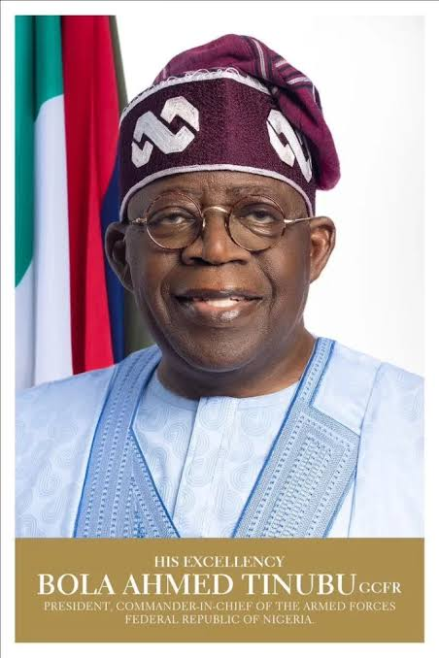
NATIONAL SECURITY AND THE TRILLION-DOLLAR ECONOMY AMBITION (CON’T)
The Trillion-Dollar Economy Ambition: A Strategic National Aspiration.
The Vision: To expand national output, strengthen productivity, attract investment, and improve global competitiveness.
Alignment with Policy: This ambition is in line with the Renewed Hope Agenda of His Excellency, President Bola Ahmed Tinubu, GCFR.
The Agenda's Pillars: The vision emphasizes strengthening national security, promoting investment, and expanding economic opportunities.
Source: MoD ALBUM, 2026

Slide 22
NATIONAL SECURITY AND THE TRILLION-DOLLAR ECONOMY AMBITION (CON’T)
Prioritizing Protection for Economic Growth: A practical security strategy must prioritize the protection of:
  Agricultural belts and transportation corridors.
  Ports and cyberspace.
  Industrial zones and mining areas.
  Energy installations and telecommunications infrastructure.
Imperative: Security considerations must be integrated into national development planning to reduce vulnerabilities and improve investment sustainability.

Slide 23
NATIONAL SECURITY AND THE TRILLION-DOLLAR ECONOMY AMBITION (CON’T)
The Accounting Profession's Charge: Measuring the Unseen Costs of Insecurity
The challenge for accountants extends to measuring the opportunity costs of insecurity, including:
  Abandoned investments.
  Disrupted economic activities.
  Reduced tax receipts.
  Damaged infrastructure.
Such assessments are essential for informed resource allocation and evaluating the economic benefits of security interventions.

Slide 24
NATIONAL SECURITY AND THE TRILLION-DOLLAR ECONOMY AMBITION (CON’T)
The Defence Sector's Broader Contribution: Beyond Operational Responsibilities
The Armed Forces contribute through internal security operations, maritime security, and the protection of critical national assets.
Economic Transformation: The defence sector can also support economic transformation through:
  Technological innovation.
  Research and engineering.
  Logistics and domestic maintenance capabilities.
Sustainable Outcomes Require: Effective inter-agency cooperation, community participation, and complementary governance and development interventions.

Slide 25
STRATEGIC PATHWAYS FOR STRENGTHENING NATIONAL SECURITY

Slide 26
STRATEGIC PATHWAYS FOR STRENGTHENING NATIONAL SECURITY (CON’T)
This section presents six strategic priorities for coordinated action:
Protecting Strategic Economic Assets
Promoting Good Governance
Strengthening Security Operations
Strengthening Defence Financial Management
Enhancing Cybersecurity and Financial Intelligence
Promoting Defence Industrial Capacity

Slide 27

STRATEGIC PATHWAYS FOR STRENGTHENING NATIONAL SECURITY (CON’T)
Strategic Pathway 1: Protecting Strategic Economic Assets: The security architecture must prioritize the protection of economic assets that are vital to sustaining economic activities.
Key Assets Include:
  Agricultural production areas.
  Transportation networks.
  Energy installations.
  Industrial facilities.
  Other critical infrastructure.
Goal: To promote investor confidence and ensure the uninterrupted flow of economic activities.

Slide 28
STRATEGIC PATHWAYS FOR STRENGTHENING NATIONAL SECURITY (CON’T)
Strategic Pathway 2: Promoting Good Governance: "Everything starts and ends with good leadership and good governance."
The Approach: We must continue to act as good leaders in whatever capacity and promote good governance.
Complementary Actions: Security must be complemented with:
  Good education.
  Employment opportunities.
  Healthcare.
  Economic growth and development.
Goal: To reduce the socio-economic vulnerabilities that are exploited by criminal organizations.

Slide 29
STRATEGIC PATHWAYS FOR STRENGTHENING NATIONAL SECURITY (CON’T)
Strategic Pathway 3: Strengthening Security Operations
The armed forces and law enforcement agencies have a responsibility to be professional and effective in achieving their mandate to defend the country.
An Assurance of Progress: "Under my leadership, I assure you that we are doing our best to achieve this mandate. We have achieved a lot in the last few months in operations and we will continue to do more."
This pathway focuses on enhancing the operational effectiveness and professionalism of security forces.

Slide 30
STRATEGIC PATHWAYS FOR STRENGTHENING NATIONAL SECURITY (CON’T)
Strategic Pathway 4: Strengthening Defence Financial Management
The need to improve:
  Budget planning and procurement governance.
  Internal controls and performance evaluation.
The Objective: To ensure that defence expenditure translates into measurable security outcomes.
The Call to Action: This requires the help of financial professionals to enhance transparency, accountability, and efficiency in the management of defence resources.

Slide 31
STRATEGIC PATHWAYS FOR STRENGTHENING NATIONAL SECURITY (CON’T)
Strategic Pathway 5: Enhancing Cybersecurity and Financial Intelligence:
The need to strengthen cooperation among:
  Financial institutions.
  Regulators.
  Security agencies.
Target Threats:
  Cybercrime.
  Money laundering.
  Illicit financial flows.
  Terrorism financing.
This pathway recognizes the increasing intersection of financial crime and national security threats.

Slide 32
STRATEGIC PATHWAYS FOR STRENGTHENING NATIONAL SECURITY (CON’T)
Strategic Pathway 6: Promoting Defence Industrial Capacity:
Encouraging partnerships among:
  Defence institutions.
  Universities and research organisations.
  Private enterprises.
Objectives:
  Develop indigenous technologies.
  Build technical expertise.
  Create sustainable maintenance capabilities.
This approach strengthens national resilience, develops technical skills, and supports broader industrial growth.

Slide 33
CONCLUSION

Slide 34

THANK YOU

